Slide 1
The Map ADT

Slide 2
The Map ADT
Model: A collection of values, each mapped by a key
Operations:

Slide 3
The Map ADT
Model: A collection of values, each mapped by a key
Operations:

Slide 4
The Map ADT
Model: A collection of values, each mapped by a key
Operations:
m = Map()

Slide 5
The Map ADT
Model: A collection of values, each mapped by a key
Operations:
m = Map() Creates an empty map

Slide 6
The Map ADT
Model: A collection of values, each mapped by a key
Operations:
m = Map() Creates an empty map
m[k] = v

Slide 7
The Map ADT
Model: A collection of values, each mapped by a key
Operations:
m = Map() Creates an empty map
m[k] = v adds value v with key k to m.

Slide 8
The Map ADT
Model: A collection of values, each mapped by a key
Operations:
m = Map() Creates an empty map
m[k] = v adds value v with key k to m.
Insert

Slide 9
The Map ADT
Model: A collection of values, each mapped by a key
Operations:
m = Map() Creates an empty map
m[k] = v adds value v with key k to m. If k already exists in m, it replaces the value already associated with k, to be v
Insert

Slide 10
The Map ADT
Model: A collection of values, each mapped by a key
Operations:
m = Map() Creates an empty map
m[k] = v adds value v with key k to m. If k already exists in m, it replaces the value already associated with k, to be v
m[k]
Insert

Slide 11
The Map ADT
Model: A collection of values, each mapped by a key
Operations:
m = Map() Creates an empty map
m[k] = v adds value v with key k to m. If k already exists in m, it replaces the value already associated with k, to be v
m[k] returns the value associated to k in m
Insert

Slide 12
The Map ADT
Model: A collection of values, each mapped by a key
Operations:
m = Map() Creates an empty map
m[k] = v adds value v with key k to m. If k already exists in m, it replaces the value already associated with k, to be v
m[k] returns the value associated to k in m
Insert
Find

Slide 13
The Map ADT
Model: A collection of values, each mapped by a key
Operations:
m = Map() Creates an empty map
m[k] = v adds value v with key k to m. If k already exists in m, it replaces the value already associated with k, to be v
m[k] returns the value associated to k in m, or raises KeyError, if k is not in m
Insert
Find

Slide 14
The Map ADT
Model: A collection of values, each mapped by a key
Operations:
m = Map() Creates an empty map
m[k] = v adds value v with key k to m. If k already exists in m, it replaces the value already associated with k, to be v
m[k] returns the value associated to k in m, or raises KeyError, if k is not in m
del m[k]
Insert
Find

Slide 15
The Map ADT
Model: A collection of values, each mapped by a key
Operations:
m = Map() Creates an empty map
m[k] = v adds value v with key k to m. If k already exists in m, it replaces the value already associated with k, to be v
m[k] returns the value associated to k in m, or raises KeyError, if k is not in m
del m[k] removes the value associated to k in m
Insert
Find

Slide 16
The Map ADT
Model: A collection of values, each mapped by a key
Operations:
m = Map() Creates an empty map
m[k] = v adds value v with key k to m. If k already exists in m, it replaces the value already associated with k, to be v
m[k] returns the value associated to k in m, or raises KeyError, if k is not in m
del m[k] removes the value associated to k in m
Insert
Find
Delete

Slide 17
The Map ADT
Model: A collection of values, each mapped by a key
Operations:
m = Map() Creates an empty map
m[k] = v adds value v with key k to m. If k already exists in m, it replaces the value already associated with k, to be v
m[k] returns the value associated to k in m, or raises KeyError, if k is not in m
del m[k] removes the value associated to k in m, or raises KeyError, if k is not in m
Insert
Find
Delete

Slide 18
The Map ADT
Model: A collection of values, each mapped by a key
Operations:
m = Map() Creates an empty map
m[k] = v adds value v with key k to m. If k already exists in m, it replaces the value already associated with k, to be v
m[k] returns the value associated to k in m, or raises KeyError, if k is not in m
del m[k] removes the value associated to k in m, or raises KeyError, if k is not in m
len(m) returns the number of entries in m
Insert
Find
Delete

Slide 19
The Map ADT
Model: A collection of values, each mapped by a key
Operations:
m = Map() Creates an empty map
m[k] = v adds value v with key k to m. If k already exists in m, it replaces the value already associated with k, to be v
m[k] returns the value associated to k in m, or raises KeyError, if k is not in m
del m[k] removes the value associated to k in m, or raises KeyError, if k is not in m
len(m) returns the number of entries in m
iter(m) returns an iterator that allows to iterate over the keys in m
Insert
Find
Delete

Slide 20
Data Structures for Map ADT
 | Find | Insert | Delete

Slide 21
Data Structures for Map ADT
 | Find | Insert | Delete
UnsortedArrayMap

Slide 22
Data Structures for Map ADT
 | Find | Insert | Delete
UnsortedArrayMap
SortedArrayMap

Slide 23
Data Structures for Map ADT
 | Find | Insert | Delete
UnsortedArrayMap
UnsortedLinkedListMap
SortedArrayMap

Slide 24
Data Structures for Map ADT
 | Find | Insert | Delete
UnsortedArrayMap
UnsortedLinkedListMap
SortedArrayMap
SortedLinkedListMap

Slide 25
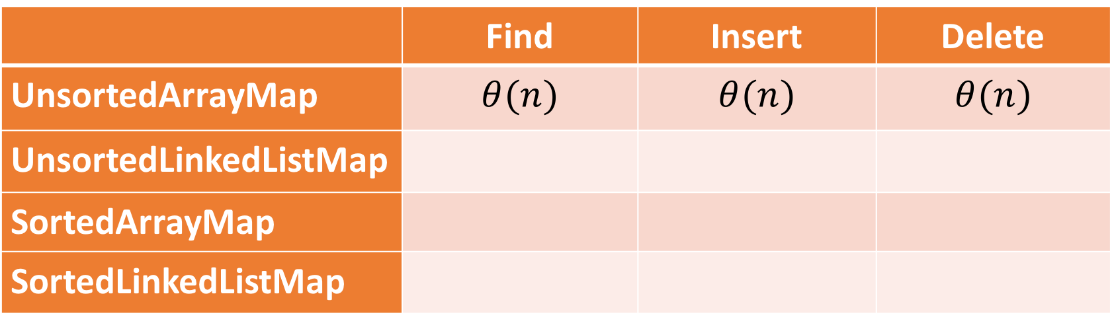
Data Structures for Map ADT
 | Find | Insert | Delete
UnsortedArrayMap | $$θ(n)$$ | $$θ(n)$$ | $$θ(n)$$
UnsortedLinkedListMap
SortedArrayMap
SortedLinkedListMap

Slide 26
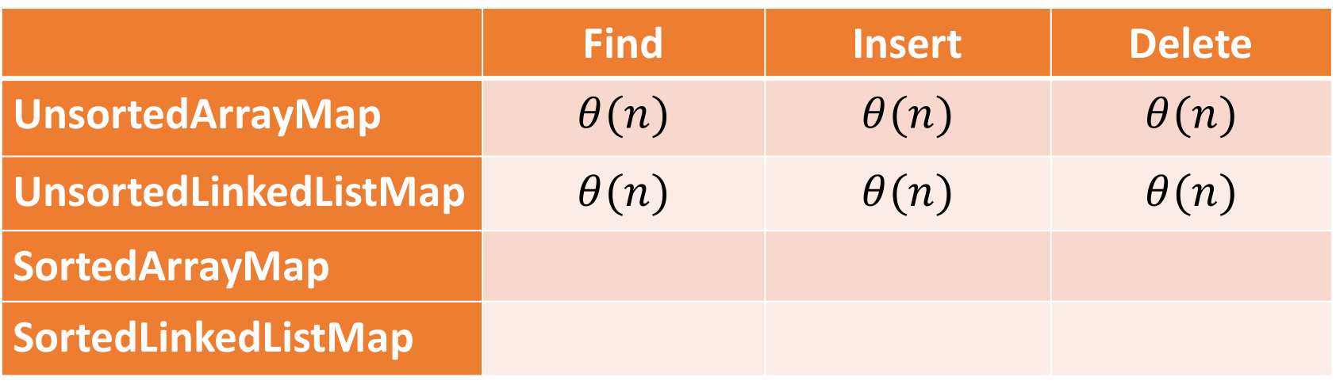
Data Structures for Map ADT
 | Find | Insert | Delete
UnsortedArrayMap | $$θ(n)$$ | $$θ(n)$$ | $$θ(n)$$
UnsortedLinkedListMap | $$θ(n)$$ | $$θ(n)$$ | $$θ(n)$$
SortedArrayMap
SortedLinkedListMap

Slide 27
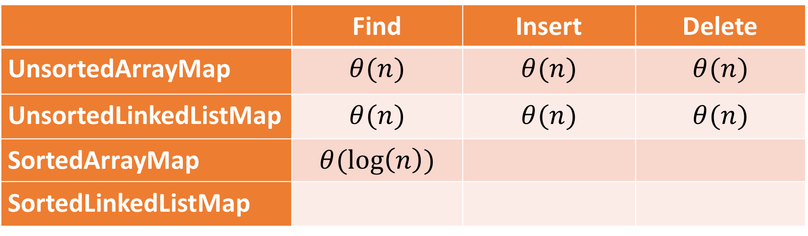
Data Structures for Map ADT
 | Find | Insert | Delete
UnsortedArrayMap | $$θ(n)$$ | $$θ(n)$$ | $$θ(n)$$
UnsortedLinkedListMap | $$θ(n)$$ | $$θ(n)$$ | $$θ(n)$$
SortedArrayMap | $$θ(\log\left(n\right))$$
SortedLinkedListMap

Slide 28
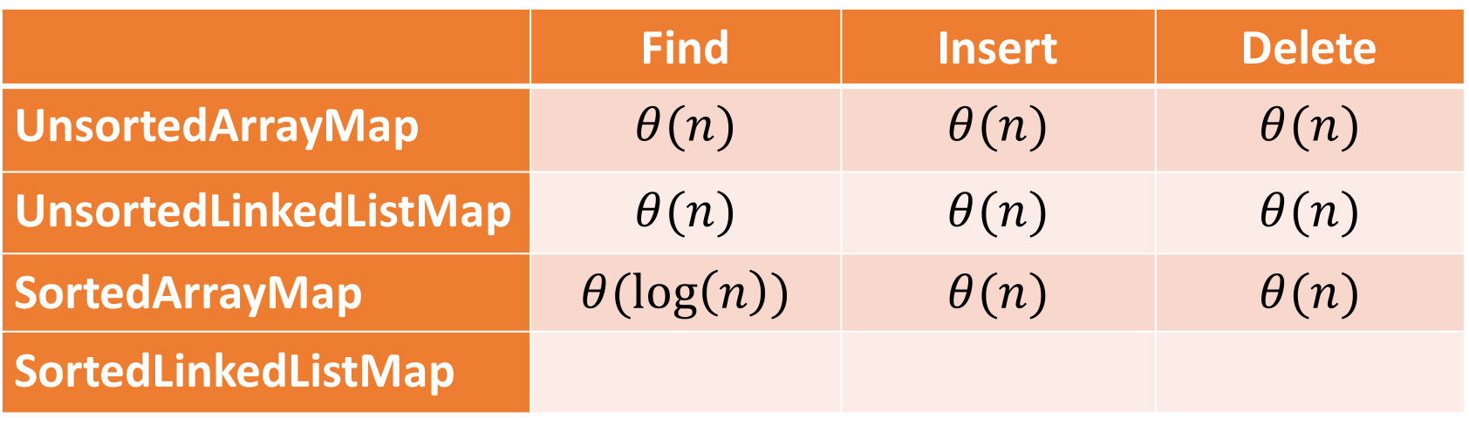
Data Structures for Map ADT
 | Find | Insert | Delete
UnsortedArrayMap | $$θ(n)$$ | $$θ(n)$$ | $$θ(n)$$
UnsortedLinkedListMap | $$θ(n)$$ | $$θ(n)$$ | $$θ(n)$$
SortedArrayMap | $$θ(\log\left(n\right))$$ | $$θ(n)$$ | $$θ(n)$$
SortedLinkedListMap

Slide 29
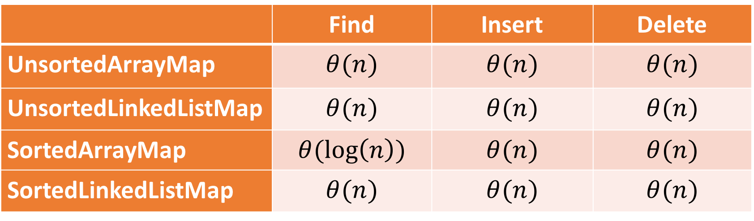
Data Structures for Map ADT
 | Find | Insert | Delete
UnsortedArrayMap | $$θ(n)$$ | $$θ(n)$$ | $$θ(n)$$
UnsortedLinkedListMap | $$θ(n)$$ | $$θ(n)$$ | $$θ(n)$$
SortedArrayMap | $$θ(\log\left(n\right))$$ | $$θ(n)$$ | $$θ(n)$$
SortedLinkedListMap | $$θ(n)$$ | $$θ(n)$$ | $$θ(n)$$

Slide 30
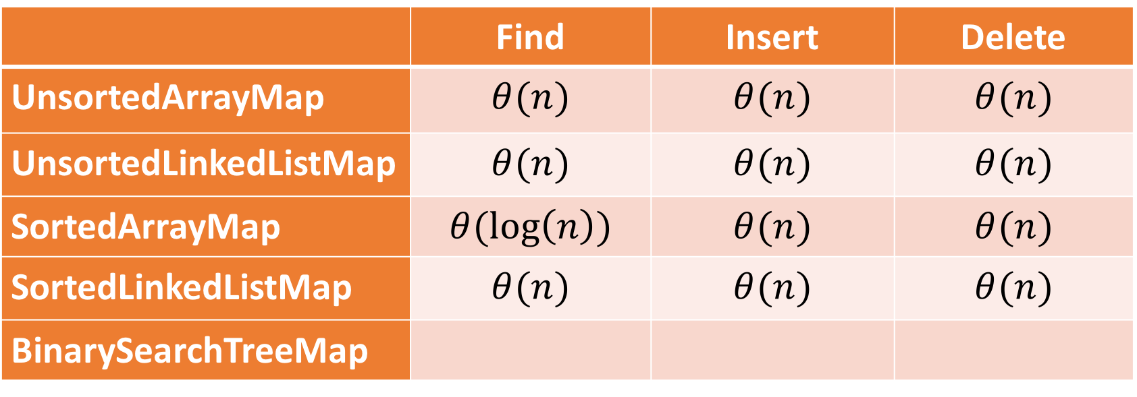
Data Structures for Map ADT
 | Find | Insert | Delete
UnsortedArrayMap | $$θ(n)$$ | $$θ(n)$$ | $$θ(n)$$
UnsortedLinkedListMap | $$θ(n)$$ | $$θ(n)$$ | $$θ(n)$$
SortedArrayMap | $$θ(\log\left(n\right))$$ | $$θ(n)$$ | $$θ(n)$$
SortedLinkedListMap | $$θ(n)$$ | $$θ(n)$$ | $$θ(n)$$
BinarySearchTreeMap

